Slide 1

FINDING CLEAN RESTAURANTS IN CHICAGO
TEAM
CHILL OUT
ANKITA VERMA, EMILY COPPESS, HEMAL AGARWAL, SUNNY JING

Slide 2




Executive Summary
Executive Summary
Our Approach
Data Clean Up/Transformation
Normalization
Data Design
Data Analysis
Data Visualization
Conclusion
Business Goal
To create a scoring system that measures restaurants’ cleanliness based on their adherence to food safety regulations imposed by the Chicago Department of Public Health
Objectives
Create a restaurant score based on violations, most recent inspection, number of complaints, number of suspected food poisoning and average of all inspection score
Create a inspection score based of violations, number of inspections and re-inspections and the results of inspections and re-inspections
Identify cleanest restaurants in a particular location. Cleanest restaurants near me
Tools Used

Slide 3
Our Approach
Executive Summary
Our Approach
Data Clean Up/Transformation
Normalization
Data Design
Data Visualization
Conclusion
Establish a scoring system for inspections and restaurants.
Analyzing the data based on different business needs
Entities were identified and relationships established between them. New Table schema introduced based on business goals
Normalization was done up to 3NF – redundancies, non atomic values, partial dependencies and transitive dependencies were removed using Excel
OpenRefine was used to cleanup the data – deletion, clustering, blank removal, font changes were carried out
Data Collection
Data Cleanup/ Transformation
Normalization
Data Design (ERD)
Data Loading
Data Analysis
Data Visualization
Data was visualized in Tableau
Data loaded using csv files in MySQL
Food Inspection Data was collection from City of Chicago data Portal

Slide 4
Data Clean Up/Transformation
Executive Summary
Our Approach
Data Clean Up/Transformation
Normalization
Data Design
Data Analysis
Data Visualization
Conclusion
Step 1: Redundant attributes deleted
Initial Attributes
Inspection ID
DBA Name
AKA Name
License #
Facility Type
Risk
Address
City
State
Zip
Inspection Date
Inspection Type
Results
Violations
Latitude
Longitude
Location
Identical to DBA Name.
Only DBA Name listed for some establishments
New Attributes
Inspection ID
DBA Name
License #
Facility Type
Risk
Address
Zip
Inspection Date
Inspection Type
Results
Violations
Latitude
Longitude
Font changed to title case.
Removed records with blank address.
All data from City of Chicago. Hence redundant information
Filled blank zip codes with addresses using Google Maps.
Redundant information

Slide 5
Data Clean Up/Transformation
Executive Summary
Our Approach
Data Clean Up/Transformation
Normalization
Data Design
Data Analysis
Data Visualization
Conclusion
Step 2: Deletion of redundant information and Clustering
Attribute Name - Facility Type
Removed facility types - café/store (uchicago), coffee kiosk (IIT), hotel, coffee/tea (wholesale shop), grocery/tavern (liquor store), main kitchen (lakeside center), restaurant/catering, restaurant/bar/theater, cafeteria, wrigely rooftop
Reason – The categories which a person usually will not try to find on a healthy restaurant finding app were removed
Bakery
Bar
Cafe
Grocery/Food Joint
Bakery/grocery
Bakery/deli
Wholesale bakery
Bakery/restaurant
Restaurant/bakery
Bar
Bar/grill
Brewery
Brewpub
Tavern
Night Club
Restaurant/ bar
Wine tasting
bar
Riverwalk café
Coffee
Coffee cart
Coffee shop
Café
Deli
Donut shop
Watermelon house
Café/store
Grocery/bakery
Grocery/ taquiera
Grocery/ (sushi prep)
Grocery store/deli
Grocery store/ restaurant
Grocery store/ bakery
Grocery store/taquiera
Restaurant/grocery store
Grocery and restaurant
Ice cream shop
Juice Bar
Small Food Joint
Restaurant
Candy/gelato
Gelato shop
Paleteria
Paleteria/ice cream shop
Protein Shake
Restaurant/protein shake
Health/juice bar
Juice and salad bar
Restaurant / gas station
Gas station/ restaurant
Rooftop restaurant
Restaurant
Restaurant and bar
Restaurant/tavern
Restaurant/ liquor
Restaurant/bar
Restaurant and Bakery

Slide 6
Data Clean Up/Transformation
Executive Summary
Our Approach
Data Clean Up/Transformation
Normalization
Data Design
Data Analysis
Data Visualization
Conclusion
Step 2: Deletion of redundant information and Clustering
Attribute Name - Inspection Type
Clustering
Complaint
Bar
Task Force
Consultation
Re-inspection
Smoking complaint
Short form complaint
Complaint
Suspect Food Poisoning
SFP
Liquor and Catering
Package Liquor
Task Force
Consultation
Pre-license consultation
Re-inspection
Re-inspection of close up
New Labels Added
Bad Labels
Special Cases
Other
Bad labels were considered as any entry with no label provided, labeled with a value meant for another column, or with the following labels: “no entry” and “tag removal”
Special cases were one time inspection events that did not fit within the predefined categories.
Special cases: corrective action, citation-reissued, finish complaint, HACCP Questionnaire, Renovation, Non-inspection, not ready, sample collection, possible FBI
The other category covers food inspections for special events such as festivals

Slide 7
Normalization
Executive Summary
Our Approach
Data Clean Up/Transformation
Normalization
Data Design
Data Analysis
Data Visualization
Conclusion
2NF
1 NF
Inspection ID
DBA Name
License #
Facility Type
Risk
Address
Zip
Inspection Date
Inspection Type
Results
Violation ID
Violation Type
Violation Level
Latitude
Longitude
Un-Normalized
Inspection ID
DBA Name
License #
Facility Type
Risk
Address
Zip
Inspection Date
Inspection Type
Results
Violations
Latitude
Longitude
Address
Address_ID
Address
Zip
Latitude
Longitude
Violation
Violation ID
Violation Type
Violation Level
Inspection
Inspection ID
Inspection Date
Inspection Type
Results
Restaurant_ID
Risk
Restaurant
Restaurant_ID
DBA Name
Facility Type
Address_ID

Slide 8
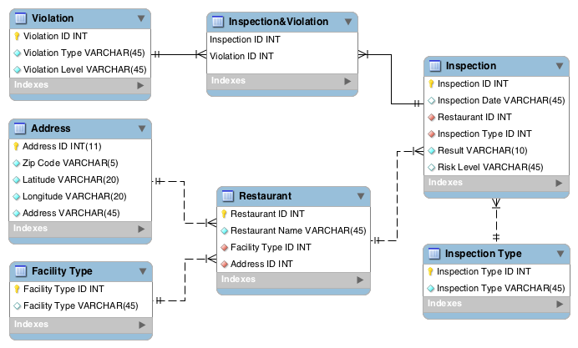
Data Design - Entity Relationship Diagram
Executive Summary
Our Approach
Data Clean Up/Transformation
Normalization
Data Design
Data Analysis
Data Visualization
Conclusion

Slide 9
Data analysis

Slide 10
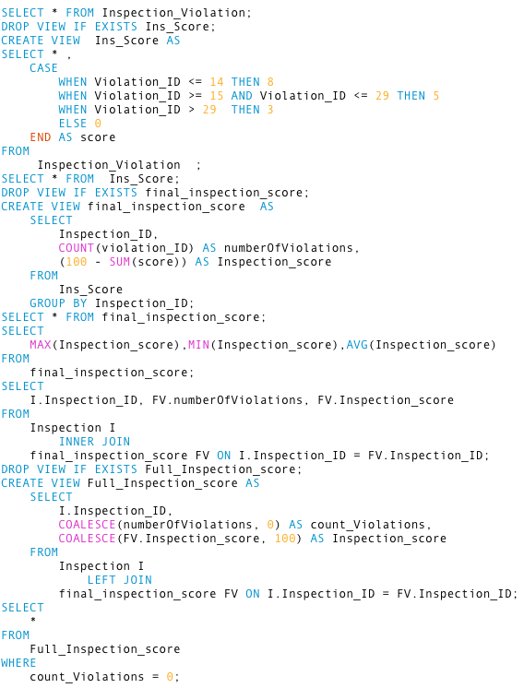
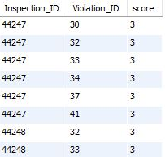
Data Analysis
Executive Summary
Our Approach
Data Clean Up/Transformation
Normalization
Data Design
Data Analysis
Data Visualization
Conclusion
Inspection Score Generated
Inspection
(100)
Critical
(-8)
Serious
(-5)
Minor
(-3)
Violation Types 1-14
Violation Types
15-29
Violation Types
30-45, 70

Slide 11
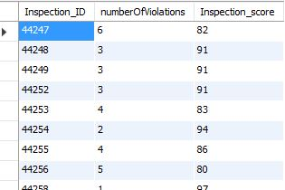
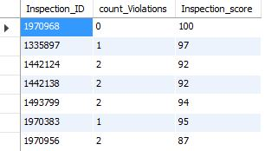
Data Analysis
Inspection type
Serious (Violations 1-13)
Critical (Violations 14-28)
Minor (Violations 29-45, 70)
Executive Summary
Our Approach
Data Clean Up/Transformation
Normalization
Data Design
Data Analysis
Data Visualization
Conclusion
-8
Inspection Score Generated
-5
Inspection
(Base 100)
-3
Violation
No Violation

Slide 12
Data Analysis
Executive Summary
Our Approach
Data Clean Up/Transformation
Normalization
Data Design
Data Analysis
Data Visualization
Conclusion
Restaurant Score Generated
Restaurant
(100)
Recent
(50% weightage)
Historical
(50% weightage)
Average
Complaints
(-5% per complaint)
Suspected Food Poisoning
(-7.5% per complaint)
Final Restaurant Score

Slide 13
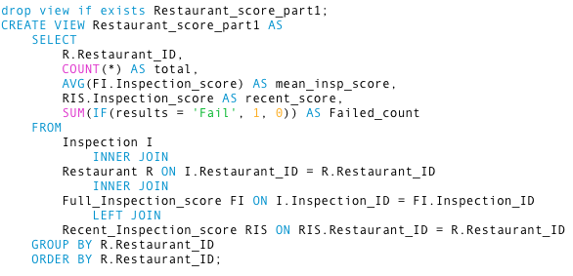
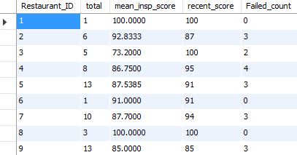
Data Analysis
Executive Summary
Our Approach
Data Clean Up/Transformation
Normalization
Data Design
Data Analysis
Data Visualization
Conclusion
Restaurant
(100)
Restaurant Score Generated
Recent
(50% weightage)
Historical
(50% weightage)
Average
Complaints
(-5% per complaint)
Suspected Food Poisoning
(-7.5% per complaint)
Final Restaurant Score

Slide 14
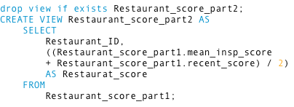
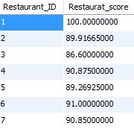
Data Analysis
Executive Summary
Our Approach
Data Clean Up/Transformation
Normalization
Data Design
Data Analysis
Data Visualization
Conclusion
Restaurant
(100)
Restaurant Score Generated
Recent
(50% weightage)
Historical
(50% weightage)
Average
Complaints
(-5% per complaint)
Suspected Food Poisoning
(-7.5% per complaint)
Final Restaurant Score

Slide 15
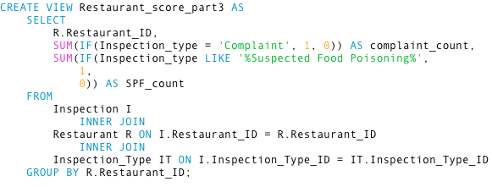
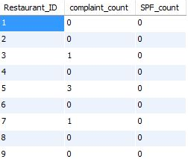
Data Analysis
Executive Summary
Our Approach
Data Clean Up/Transformation
Normalization
Data Design
Data Analysis
Data Visualization
Conclusion
Restaurant
(100)
Restaurant Score Generated
Recent
(50% weightage)
Historical
(50% weightage)
Average
Complaints
(-5% per complaint)
Suspected Food Poisoning
(-7.5% per complaint)
Final Restaurant Score

Slide 16
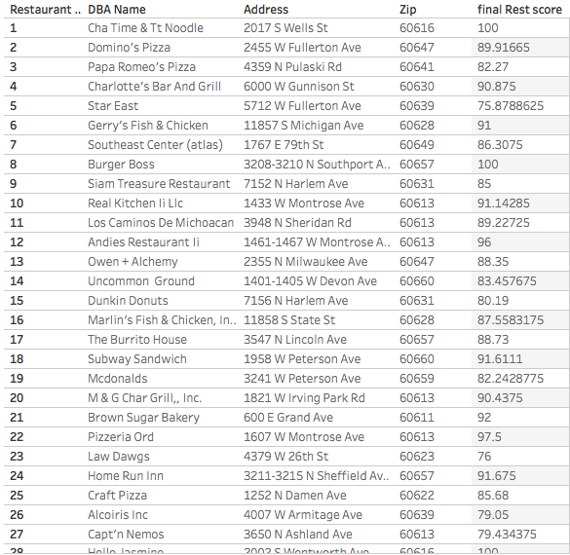
Data Analysis
Executive Summary
Our Approach
Data Clean Up/Transformation
Normalization
Data Design
Data Analysis
Data Visualization
Conclusion
Restaurant
(100)
Final Restaurant Score Generated
Recent
(50% weightage)
Historical
(50% weightage)
Average
Complaints
(-5% per complaint)
Suspected Food Poisoning
(-7.5% per complaint)
Final Restaurant Score

Slide 17
Data visualization

Slide 18
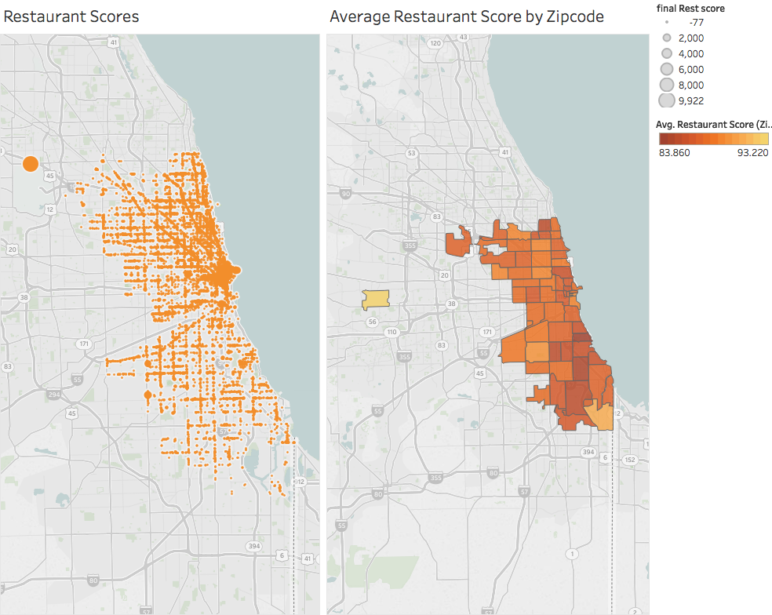
Data Visualization
Executive Summary
Our Approach
Data Clean Up/Transformation
Normalization
Data Design
Data Analysis
Data Visualization
Conclusion
The average restaurant score in an area varied from 83.86 to 93.22

Slide 19
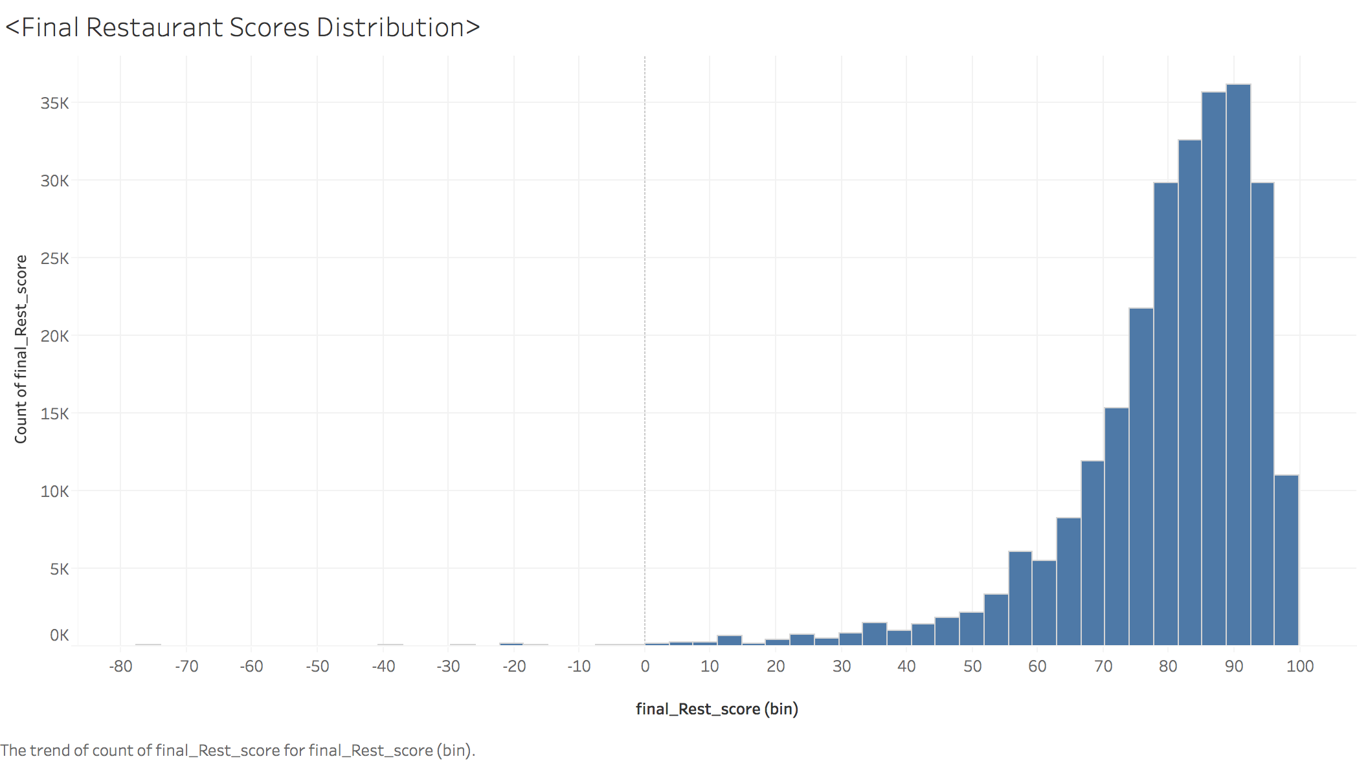
Data Visualization
Executive Summary
Our Approach
Data Clean Up/Transformation
Normalization
Data Design
Data Analysis
Data Visualization
Conclusion
 | Final Restaurant Score
Maximum | 100
Minimum | -76.71
Average | 87.61
Median | 90.41
The restaurant score varied from -76.71 to 100 with the mean score being 87.61 and median score 90.41

Slide 20
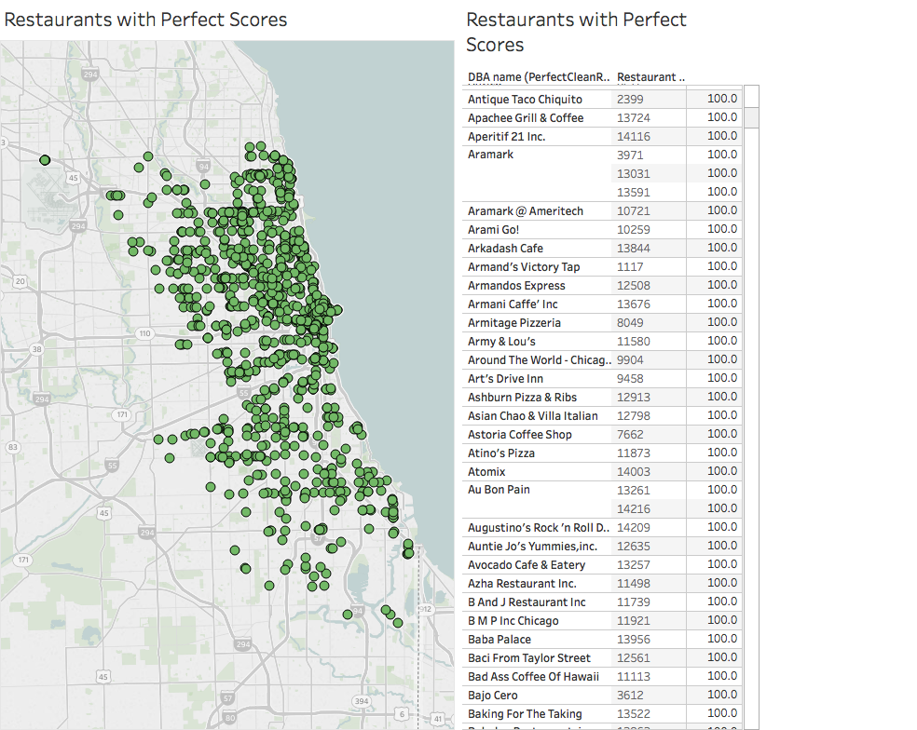
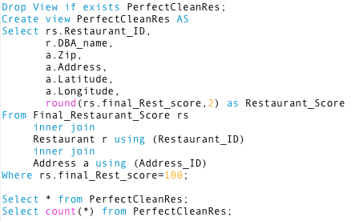
Data Visualization
Executive Summary
Our Approach
Data Clean Up/Transformation
Normalization
Data Design
Data Analysis
Data Visualization
Conclusion
As many as 1105 restaurants had perfect score of 100. They were spread in all parts of Chicago but mainly concentrated in North and Central. South Chicago had fewer restaurants with perfect scores

Slide 21
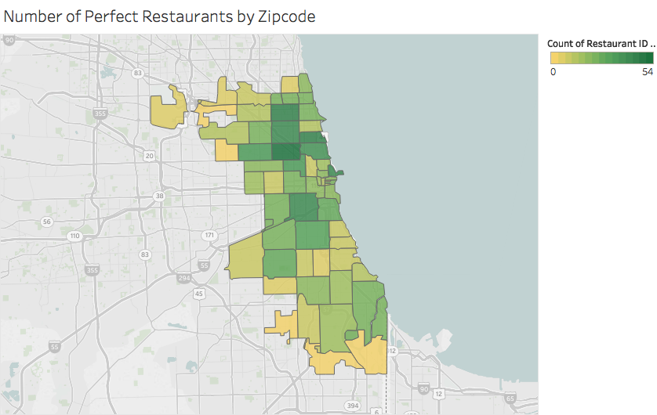
Data Visualization
Executive Summary
Our Approach
Data Clean Up/Transformation
Normalization
Data Design
Data Analysis
Data Visualization
Conclusion
While some of the zip codes had 0 restaurants with perfect scores, some zip codes had 54 restaurants with perfect scores

Slide 22
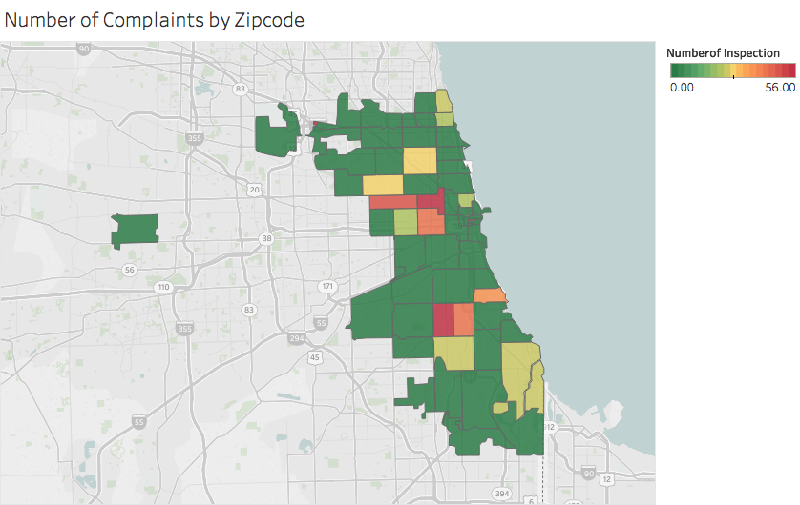
Data Visualization
Executive Summary
Our Approach
Data Clean Up/Transformation
Normalization
Data Design
Data Analysis
Data Visualization
Conclusion
While most of the zip codes had 0 complaints, some of the areas had as high as 56 complaints.

Slide 23
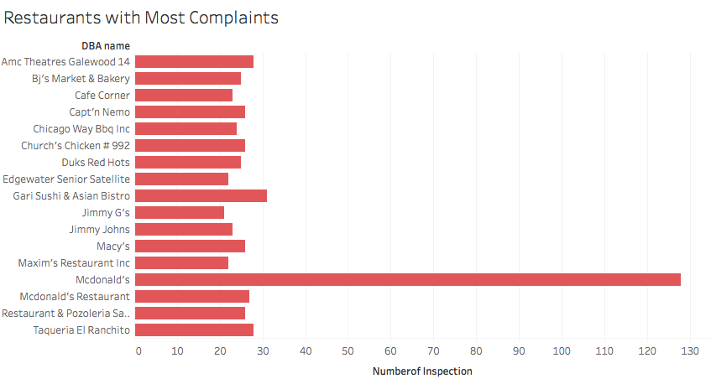
Data Visualization
Executive Summary
Our Approach
Data Clean Up/Transformation
Normalization
Data Design
Data Analysis
Data Visualization
Conclusion
McDonald’s topped all the restaurants with maximum number of complaints

Slide 24
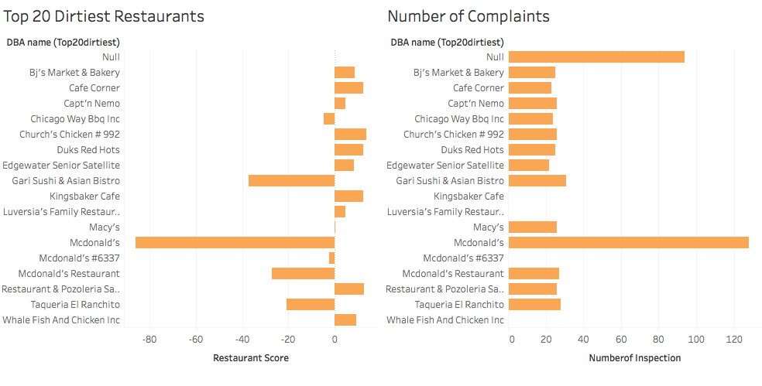
Data Visualization
Executive Summary
Our Approach
Data Clean Up/Transformation
Normalization
Data Design
Data Analysis
Data Visualization
Conclusion
McDonald’s on S Lafeyette Ave was ranked as the most dirtiest restaurant and also the restaurant with maximum number of complaints

Slide 25
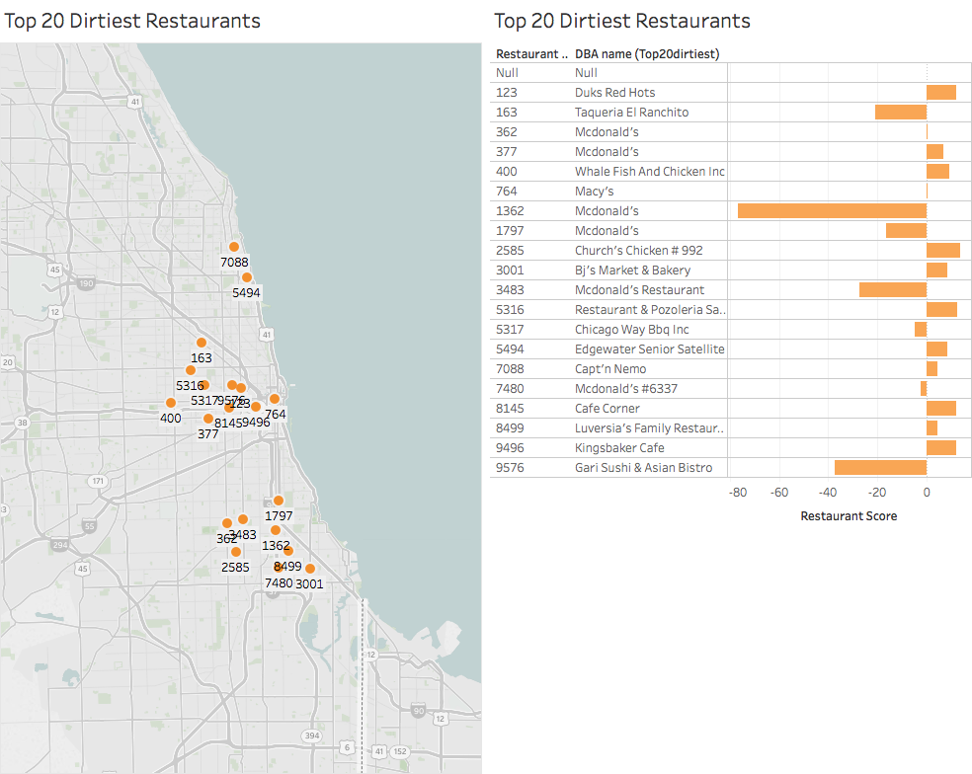
Data Visualization
Executive Summary
Our Approach
Data Clean Up/Transformation
Normalization
Data Design
Data Analysis
Data Visualization
Conclusion
A lot of restaurants also scored negative due to a lot of complaints. Most of these restaurants were located in central part of Chicago

Slide 26
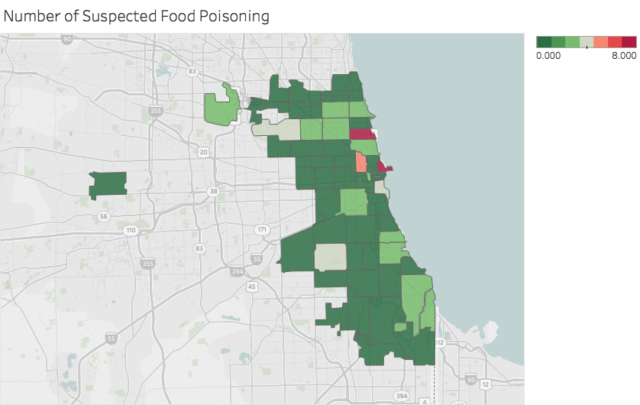
Data Visualization
Executive Summary
Our Approach
Data Clean Up/Transformation
Normalization
Data Design
Data Analysis
Data Visualization
Conclusion
Number of food poisoning ranged from 0 to 8 in an area with north of Chicago having more such cases

Slide 27
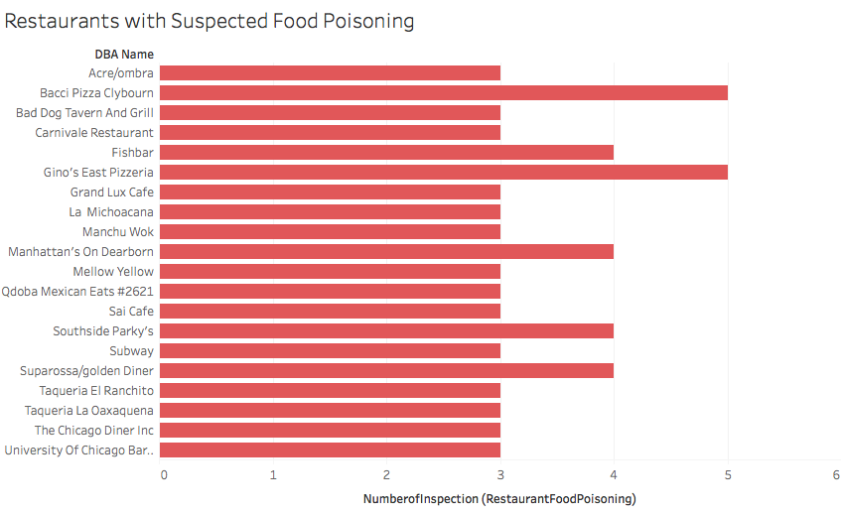
Data Visualization
Executive Summary
Our Approach
Data Clean Up/Transformation
Normalization
Data Design
Data Analysis
Data Visualization
Conclusion
Pizzerias topped in the number of food poisoning complaints

Slide 28
What happens Near gleacher center?

Slide 29
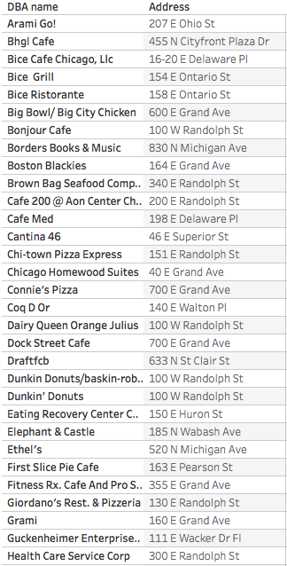
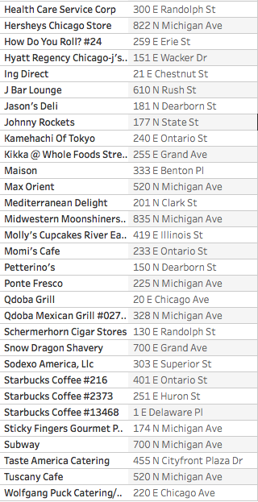
Data Visualization
Executive Summary
Our Approach
Data Clean Up/Transformation
Normalization
Data Design
Data Analysis
Data Visualization
Conclusion
60 restaurants had perfect scores near Gleacher Center, the average score was 87.71

Slide 30
Data Visualization
Executive Summary
Our Approach
Data Clean Up/Transformation
Normalization
Data Design
Data Analysis
Data Visualization
Conclusion
While most of the restaurants had close to perfect scores in 0.5mile radius of Gleacher, the lowest score was 14.75

Slide 31
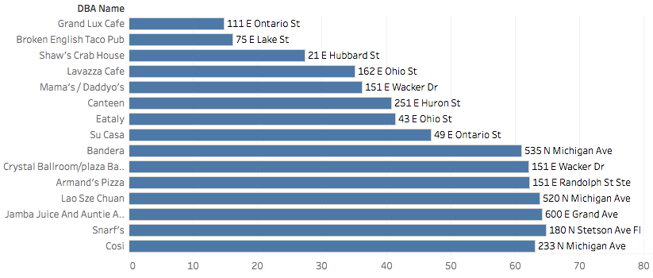
Data Visualization
Executive Summary
Our Approach
Data Clean Up/Transformation
Normalization
Data Design
Data Analysis
Data Visualization
Conclusion
Grand Lux Café and Broken English Taco pub had the lowest scores
Broken English Taco pub and The Great State Fare had the maximum complaints
Lowest Scores
Maximum Complaints

Slide 32
Conclusion
Executive Summary
Our Approach
Data Clean Up/Transformation
Normalization
Data Design
Data Analysis
Data Visualization
Conclusion
Lessons Learned
End to End Data Analysis from both macro and micro perspectives
Optimization of performance of SQL queries and data uploading
Interactive data visualizations using Tableau
Team coordination and managing team dynamics
Areas of Improvement
A better scoring system with a more nuanced analysis of violations and inspections results
A more refined way of importing data which can get refreshed & updated on regular basis
Better cleaning process to get more refined data
Future Scope
The work can be further extended to derive a correlation between the socio economic factors and the cleanliness of the restaurants in that area
The study can be integrated with Yelp Ratings, Zomato and Google Ratings to create a live platform to evaluate and find a restaurant based on customer reviews, types of cuisines, availability of healthy gluten free options combined with updated food inspection results

Slide 33
Q & A

Slide 34
appendix

Slide 35
Entity Relationship Diagram
Elements | Values
Entities | Violation, Address, Restaurant, Inspection, Inspection Type, Facility Type
Attributes | Restaurant – Restaurant ID, Restaurant Name Inspection – Inspection ID, Inspection Date, Result, Risk Level Violation – Violation ID, Violation Type, Violation Level Address – Address ID, Address, Zip Code, Latitude, Longitude Inspection Type – Inspection Type ID, Inspection Type Facility Type – Facility Type ID, Facility Type
Primary Keys | Restaurant - Restaurant ID Inspection - Inspection ID Address - Address ID Violation - Violation ID Facility Type - Facility Type ID Inspection Type - Inspection Type ID
Foreign Keys | Restaurant – Facility Type ID, Address ID Inspection – Inspection Type ID, Restaurant ID

Slide 36
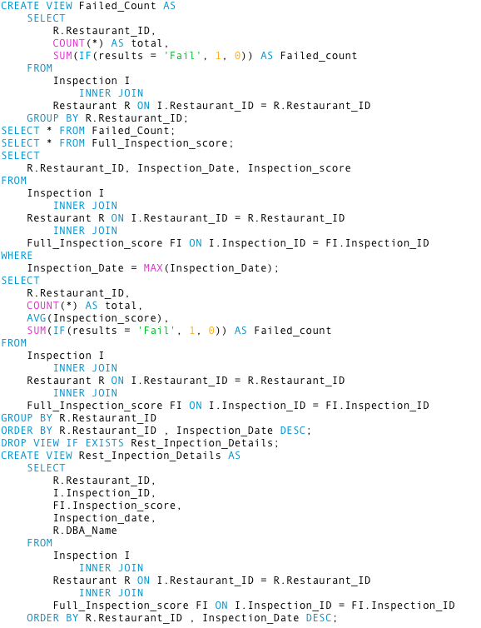
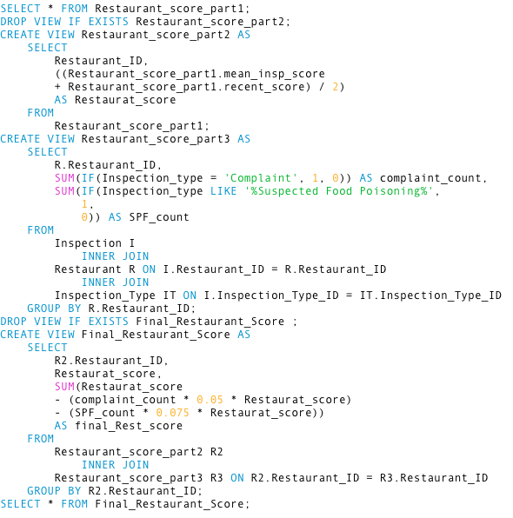
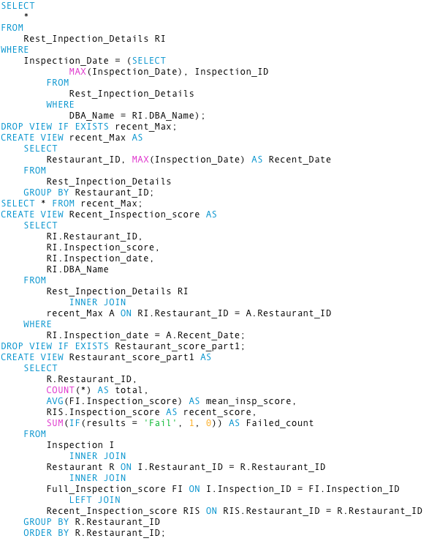
Queries
Restaurant Score Generated

Slide 37
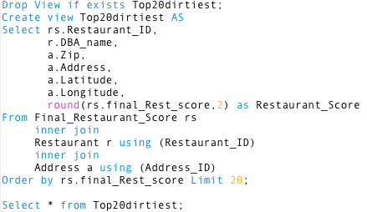
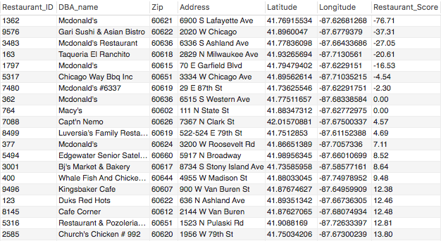
Queries
Top 20 Dirtiest Restaurants

Slide 38
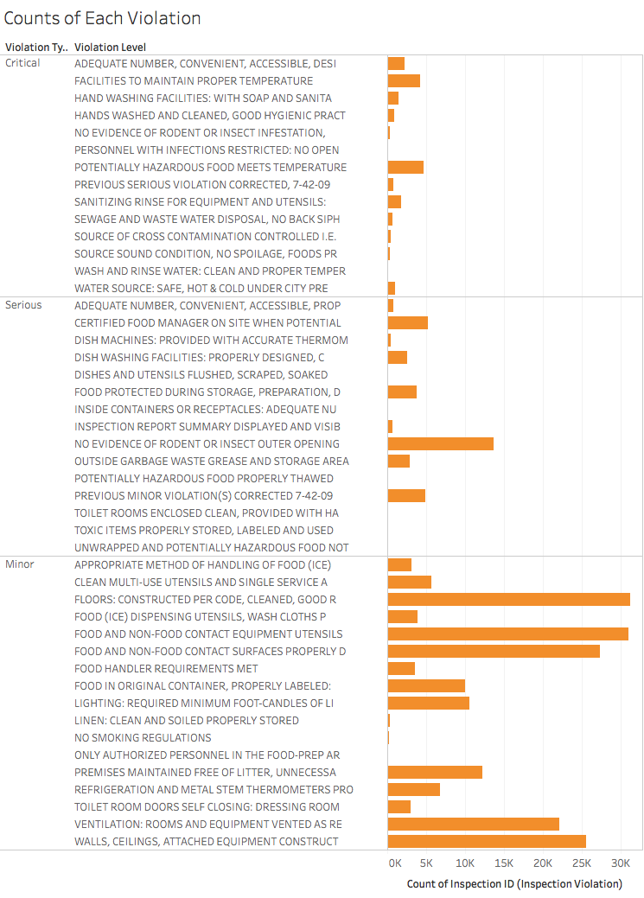
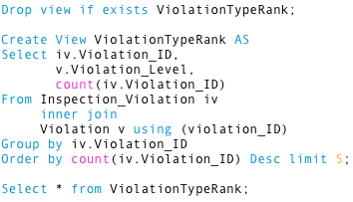
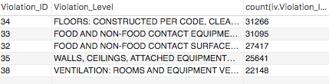
Queries
Counts for Each Type of Violation

Slide 39
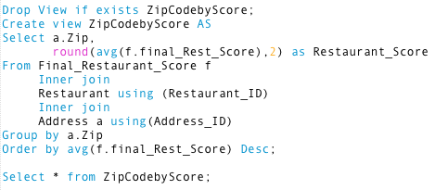
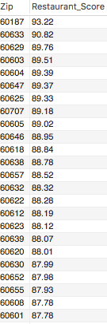
Queries
Average score in a zip code

Slide 40
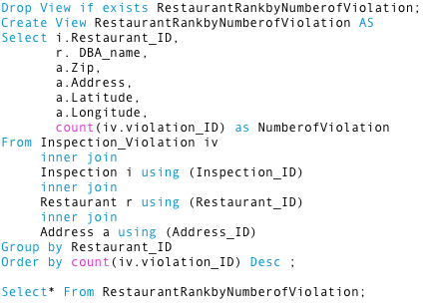
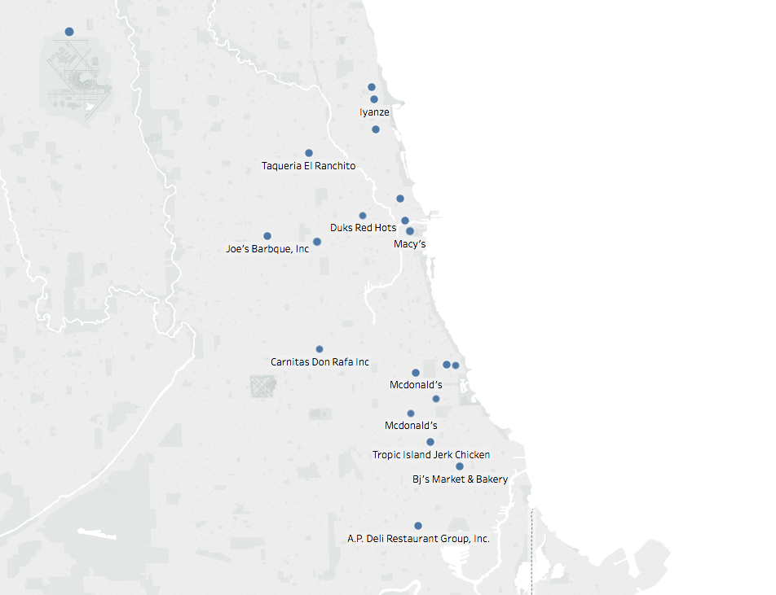
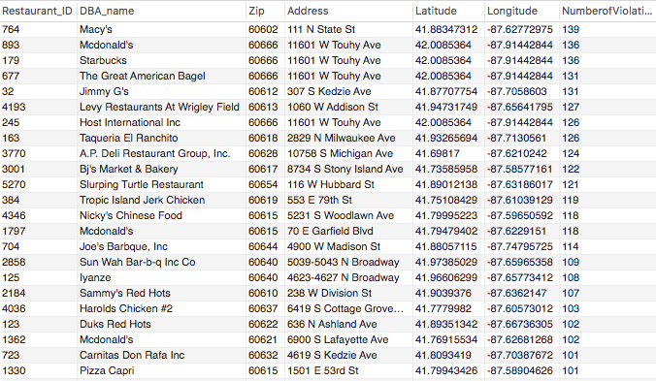
Queries
Restaurant ranking by number of violations

Slide 41
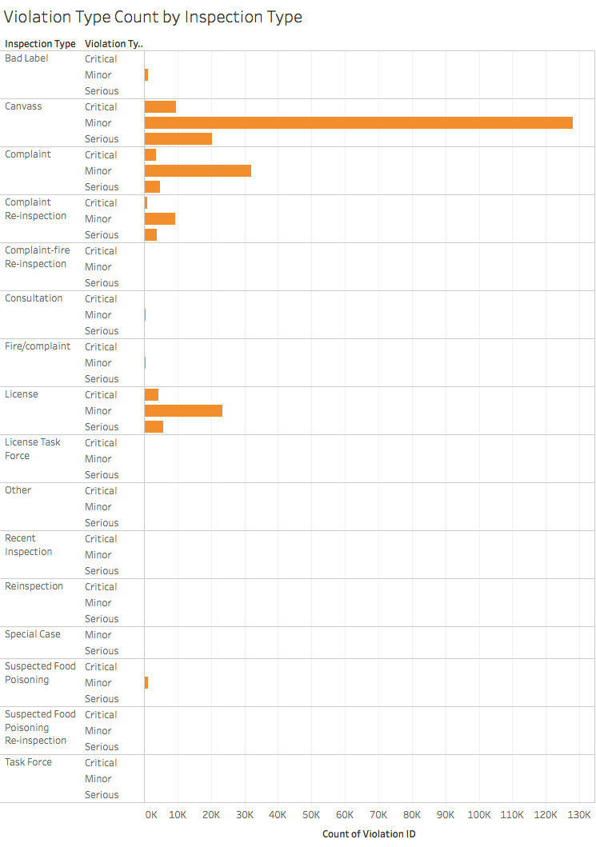
Data Visualization
Most violations tend to be minor violations and found during canvas inspections.

Slide 42
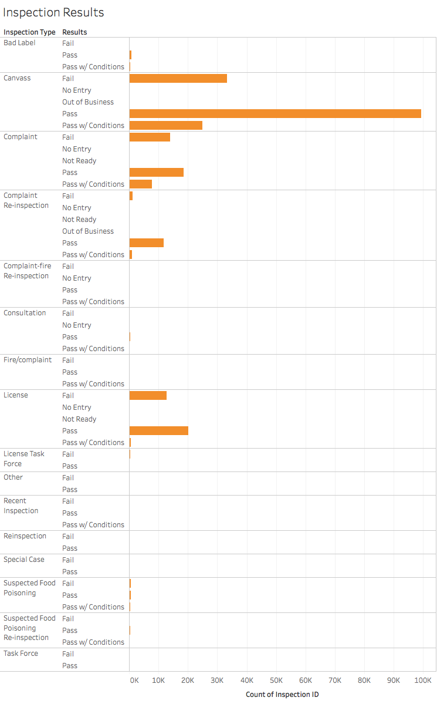
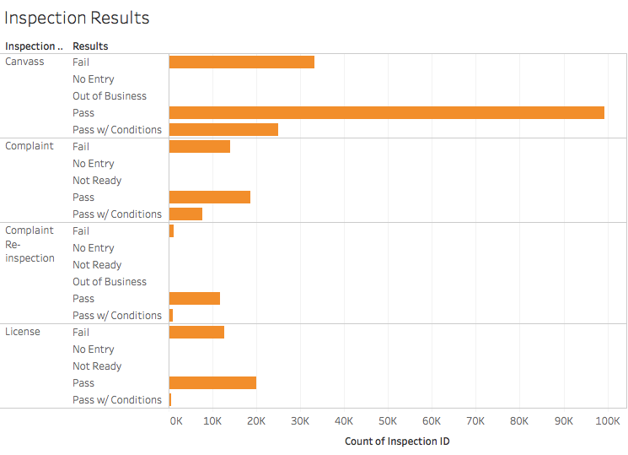
Data Visualization
Results by Inspection Type

Slide 43
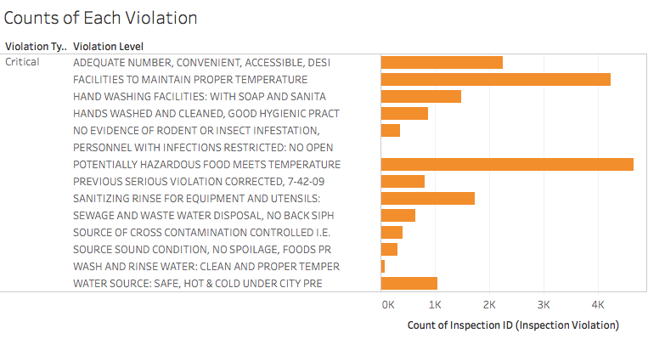
Data Visualization
Most critical violations found during inspections are related to temperature control and sanitization procedures.

Slide 44
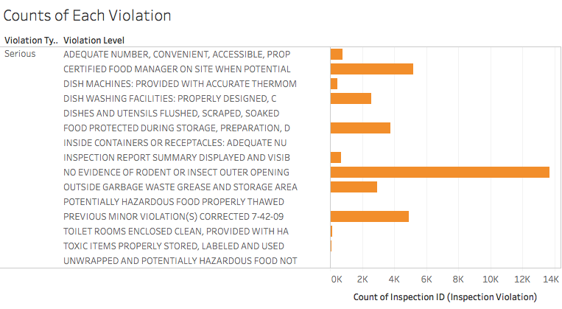
Data Visualization
Most severe violations were related to pest control issues and failure to correct previous infractions.

Slide 45
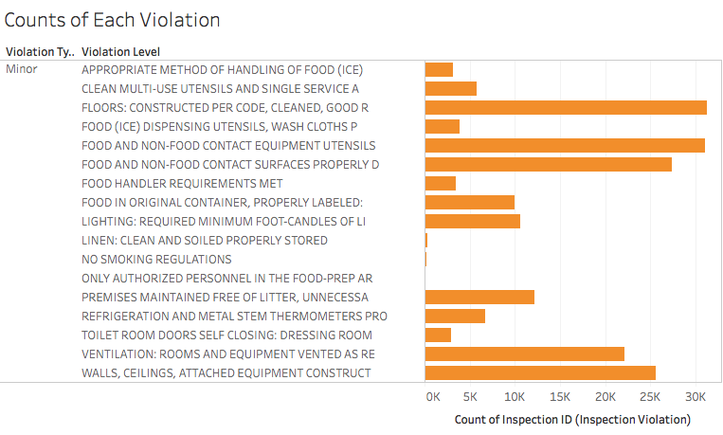
Data Visualization
Most minor violations are related to maintenance issues.

